Slide 1

Business Analytics with R
GROUP 11

Slide 2
Agenda
According to McKinsey's auto retail micro-market model, Americans purchase approximately 39.4 million used cars annually compared to 17.3 million new vehicles (2018) and used-vehicle sales are expected to grow more rapidly than new-vehicle sales over the next five years.
Currently, due to the factors contributing to rising prices in the pre-owned vehicle market such as microchip shortage, limited supply of new vehicles, and increased demand may lead to customers overpaying for their cars.
Pricing analytics can be instrumental in helping both customers and companies navigate this dilemma by evaluating the market price of a vehicle before purchasing or selling it.
This project aims to achieve two main objectives:
• Estimate the price of a used car by considering a range of features, drawing from historical data.
• Gain deeper insight into the most significant features that contribute to determining the price of a used vehicle.

Slide 3
Introduction to the Data
To build the model, a secondary dataset from Kaggle (Data Link) is used. This dataset is updated monthly using web scraping techniques from US Craigslist posts(the world’s largest collection of used vehicles for sale)
The Database consists of 426,880 rows and 26 features, one of which is the continuous dependent variable (“price”) that we want to predict.
Apart from price, the other important features are model, odometer, age, condition, manufacturer and so on.
The large amount of data helps us to improve the accuracy of the model. The attributes can be easily related with each other, and we can easily infer the desired objective.
The data is examined using an array of linear regression models. Ultimately, we draw a conclusion by identifying the most accurate model for price prediction.
There are however some considerable of number of missing values therefore data cleansing is required, but other than this dataset has all that we need to build the model that we desire.

Slide 4
Data Preprocessing
Handling missing data
Remove duplicates
Outlier detection

Slide 5
Data Preprocessing
Handling missing data
Remove duplicates
Outlier detection
Features considered
'region','price','year','model','condition','cylinders’,
’fuel','odometer','title_status','transmission','drive’
‘size’,'type','paint_color','state','posting_date’,
'manufacturer'

Slide 6
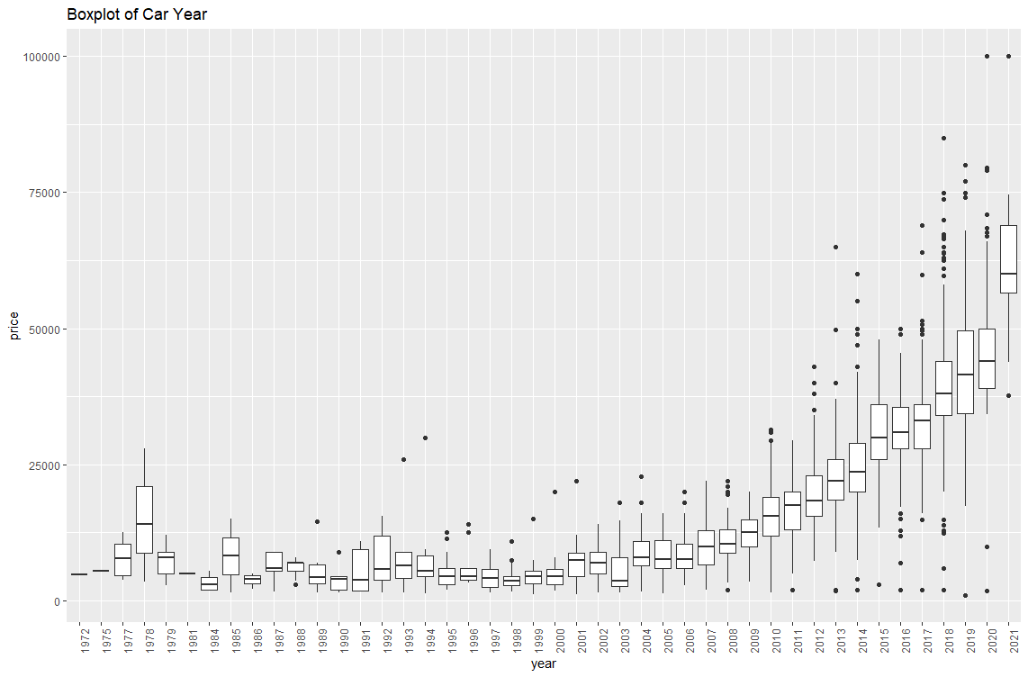
Exploratory data analysis
Let’s start with looking for outliers in the data by analyzing the outliers by plotting the boxplots.

Slide 7
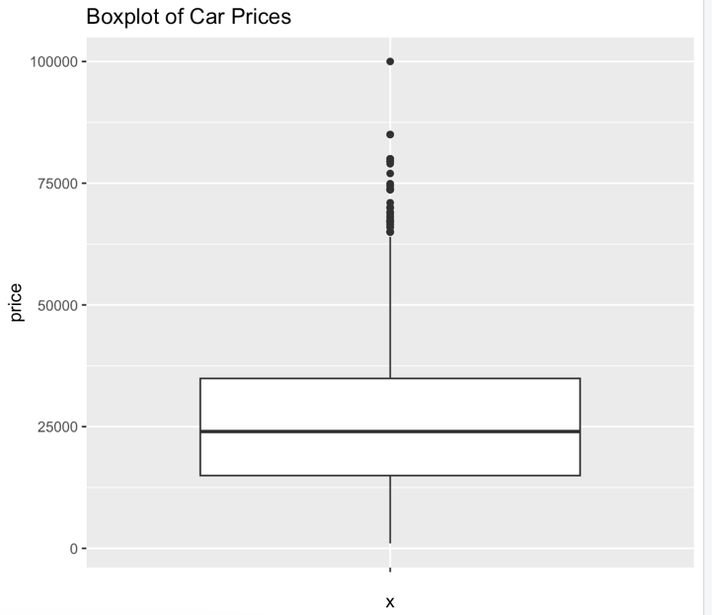
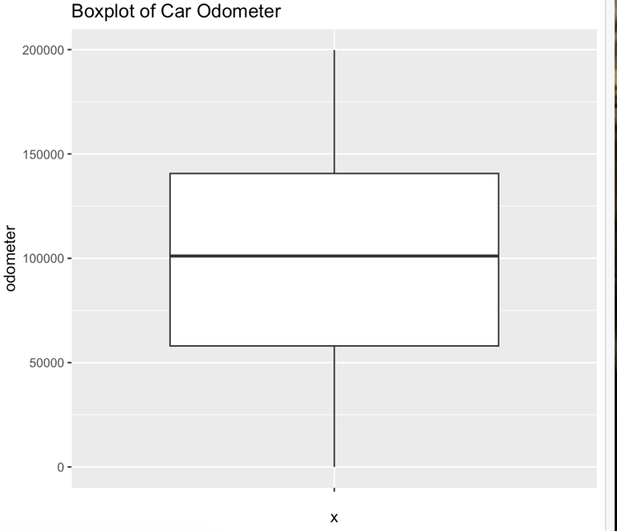
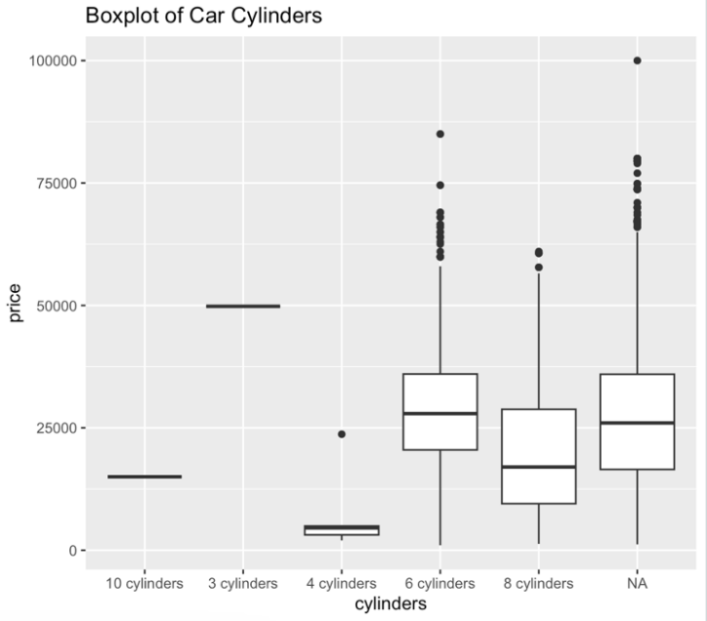
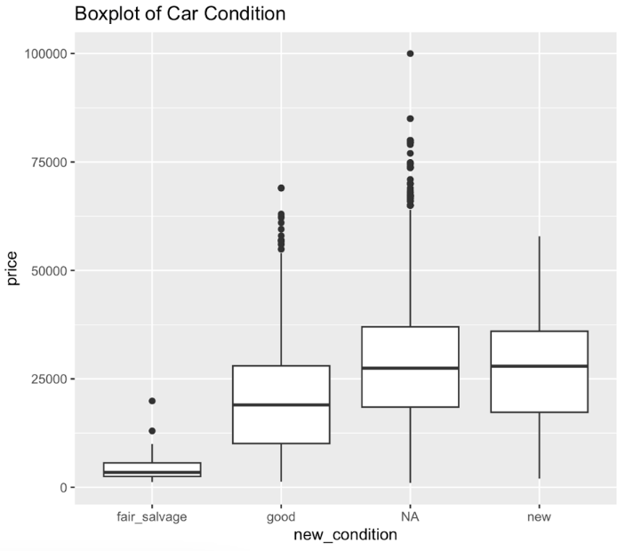

Slide 8
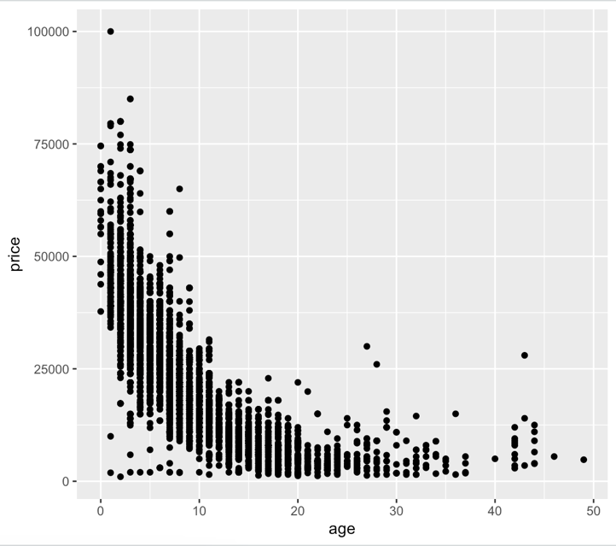
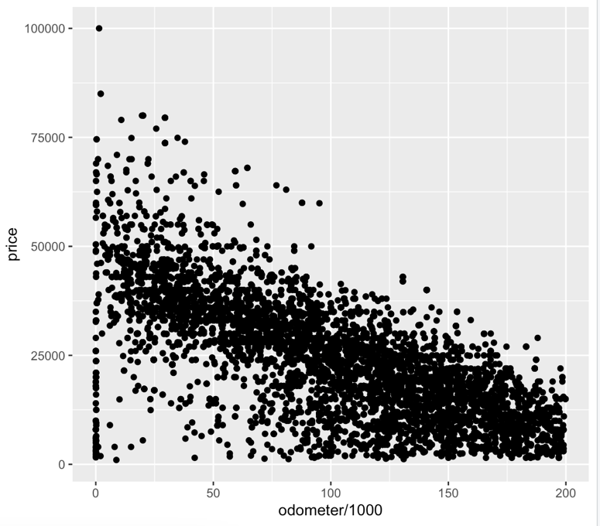
After that we look at the numerical variables age and odometer.

Slide 9
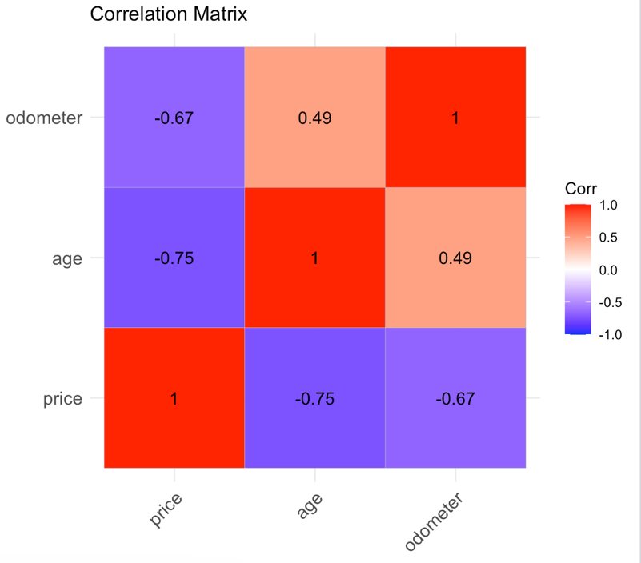
Next, we examine the correlation matrix

Slide 10
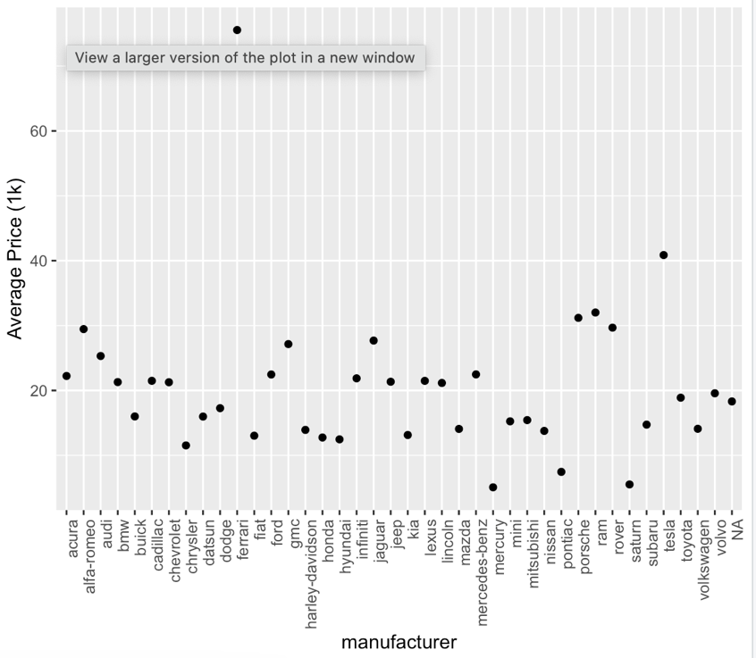
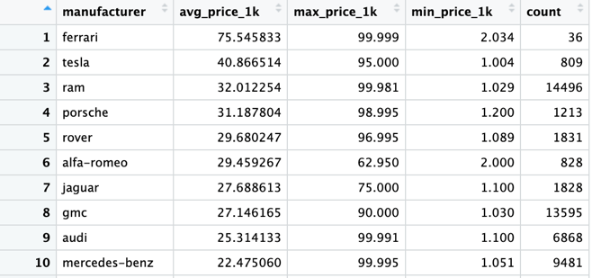
Next, we work on further exploratory analysis on the data. First, we want to see who are the top manufacturers and their average prices.

Slide 11
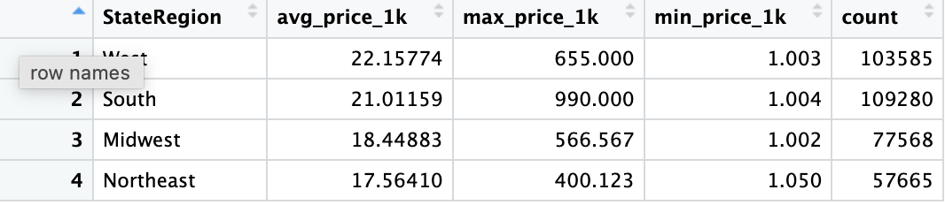
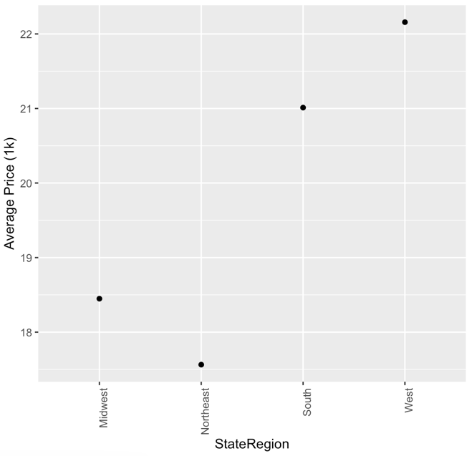
Average car prices based on region.

Slide 12
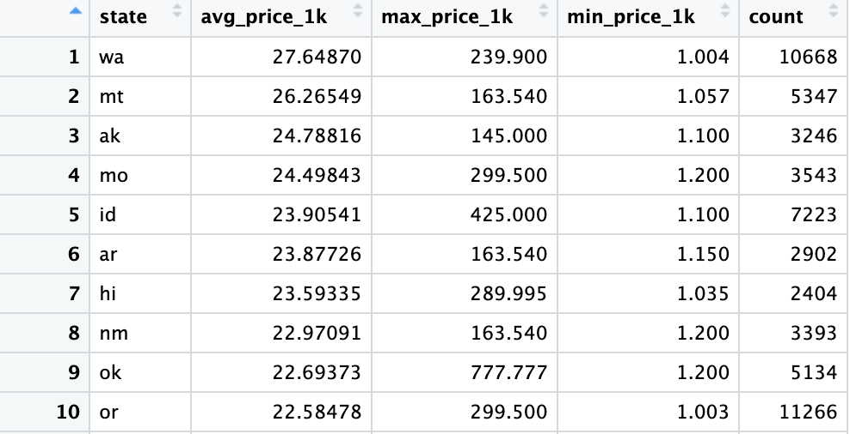
Average car prices based on states.

Slide 13
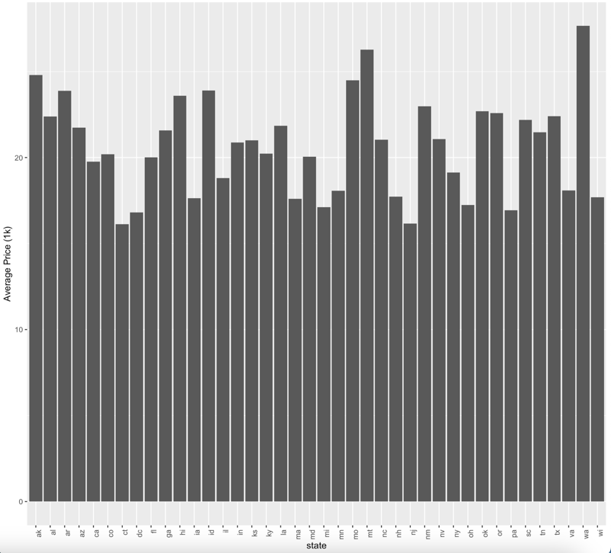
Plot:

Slide 14
Modelling
Linear Regression for predicting Used Car Prices
Evaluated multiple variables – Age, Odometer, Condition, StateRegion, Transmission, Type of Car, Paint Color, Number of Cylinders.
Finalized Age, Odometer as the features for the building the final regression model.
Dropped other variables because of high p-value.
Tested various model and finalized the model having highest R Squared value and coefficients having p-values less than 0.05.
Final Model has Age^2 and Age*Odometer along with Age, and Odometer . finalmodel <- lm(price ~ age+I(age^2)+odometer_1k+age:odometer_1k , data = d_subset_check)

Slide 15
Modelling
Final Model has Age^2 and Age*Odometer along with Age, and Odometer . finalmodel <- lm(price ~ age+I(age^2)+odometer_1k+age:odometer_1k , data = d_subset_check)
User needs to input Car Model, Age of the Car and Odometer Reading (in 1k multiple) to get the predicted price of the car.
Apart from Age and Odometer Reading, we have added Age^2 and Age*Odometer
Age^2 – To capture differential Depreciation with respect to age
Age*Odometer – To capture non-linear relationship between age and price

Slide 16
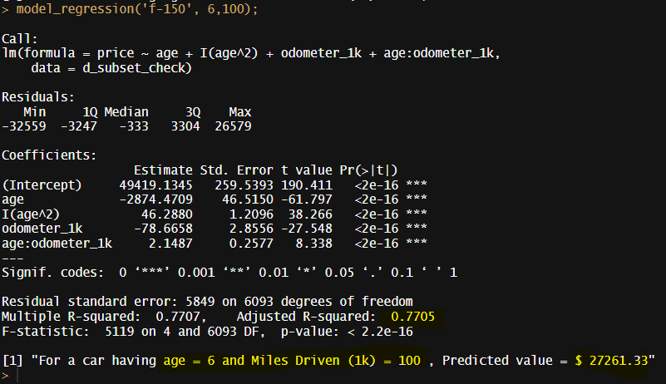
Regression Output
Car Model – F-150 Car Age – 6 Odometer reading – 100k

Slide 17
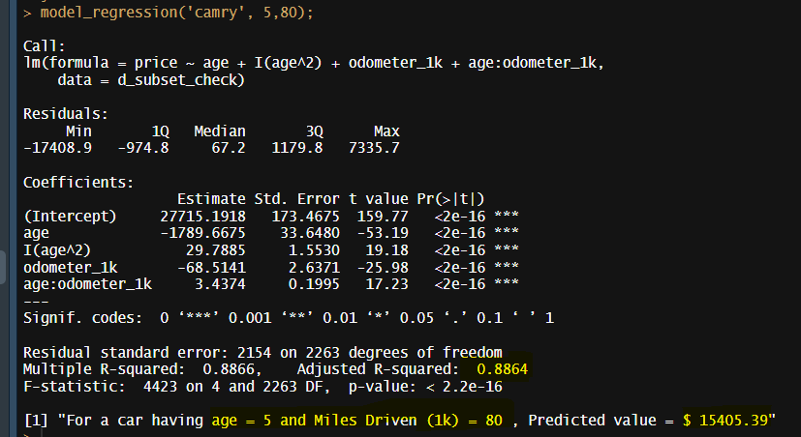
Regression Output
Car Model – Camry Car Age – 5 Odometer reading – 80k

Slide 18
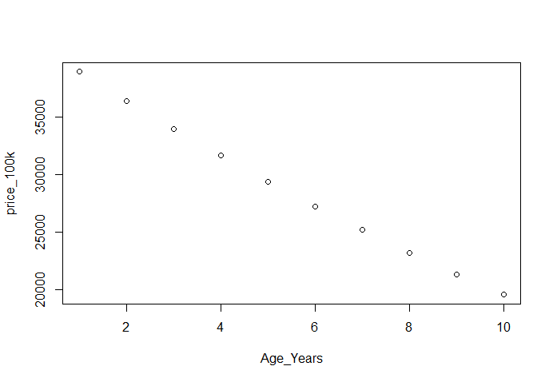
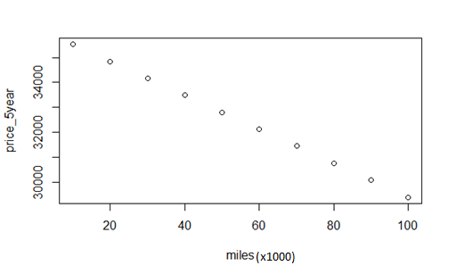
Insights from the Model
Effect of age when miles driven is constant (=100k) for Car Model F-150 on Price.
Effect of miles driven when age is constant (=5 Years) for Car Model F-150 on Price.

Slide 19
Conclusion
Odometer and Age are primary variables to determine car prices
This is a good model to estimate the fair price of a used car, however there could be some factors that the model cannot capture
Our model does not take modifications into account and users should keep that in mind while interpreting car price
The rate of depreciation is higher in the initial years, and it slows down as the car ages

Slide 20
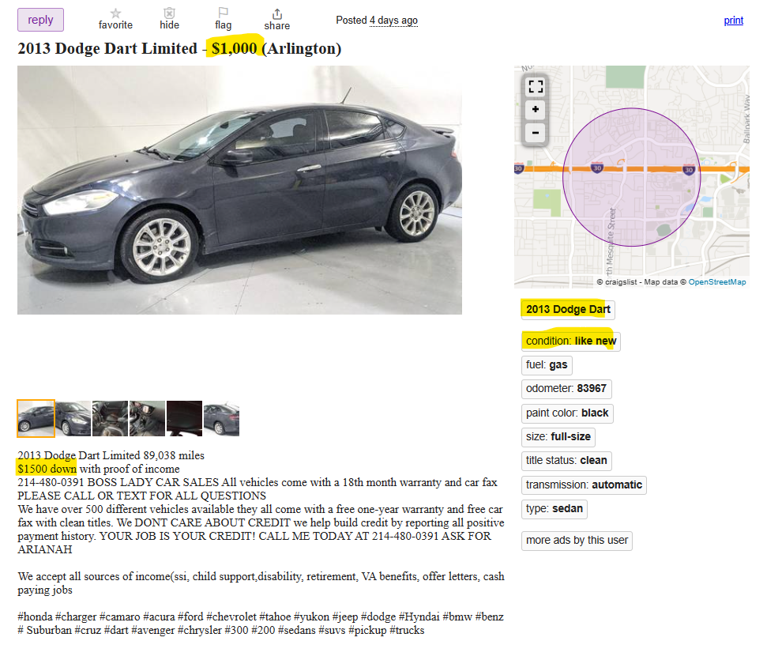

Slide 21
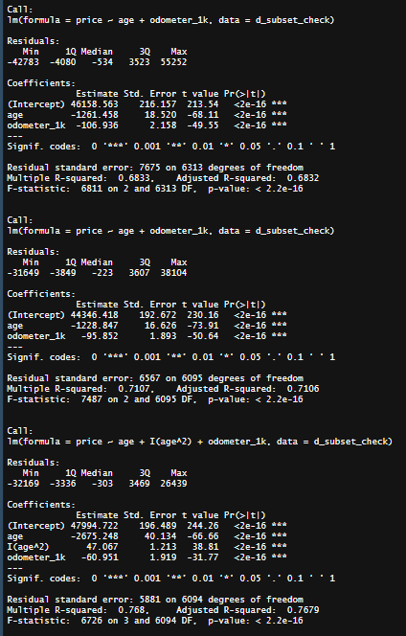
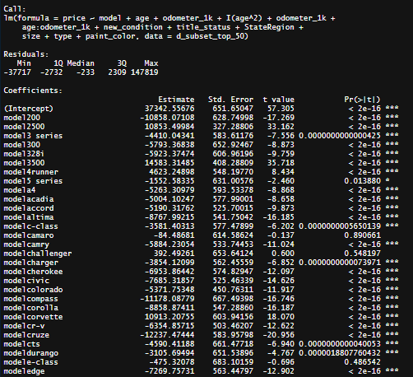
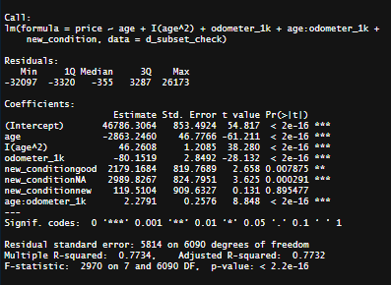
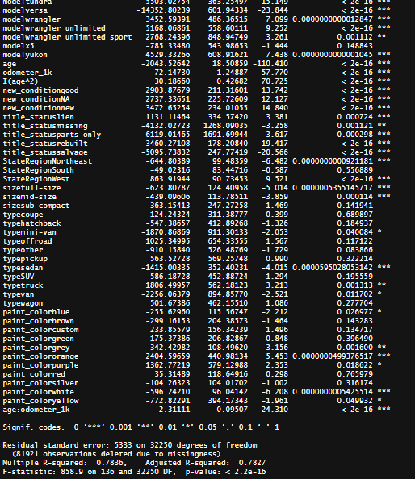
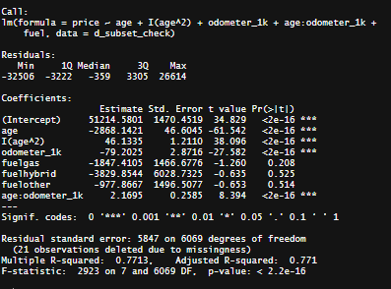
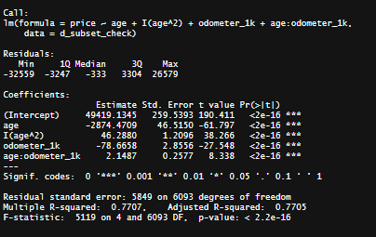

















Slide 22
